Slide 1

Predicting Hotel Cancellations
Valerie Zixi Li
Sociology Ph.D. Student, Affiliated with Population Studies and Training Center
https://github.com/ZixiLi76/Hotel-Cancellation-Prediction
Jan 20 2025

Slide 2
Recap – Question & Data
Question: What factors affect hotel cancellations?
Optimize revenue management, enhance customer experience, improve operational efficiency
Hotel booking demand dataset from Kaggle: https://www.kaggle.com/datasets/jessemostipak/hotel-booking-demand/data
The dataset: booking & cancellation details for city and resort hotels, featuring variables like booking dates, length of stay, guest count, # of special requests, …, with all personal information removed
Collection methodology: data was sourced from ScienceDirect and cleaned by Thomas Mock and Antoine Bichat for #TidyTuesday, available on GitHub.
Target variable (y): is_canceled (dichotomous) – classification problem

Slide 3
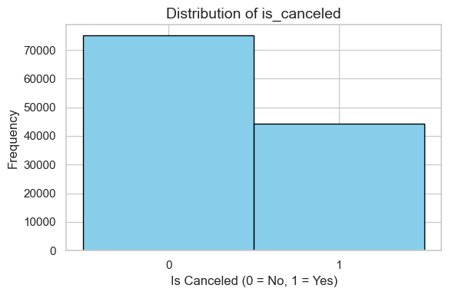
Recap – EDA – Cancellations & Hotel Type

Slide 4
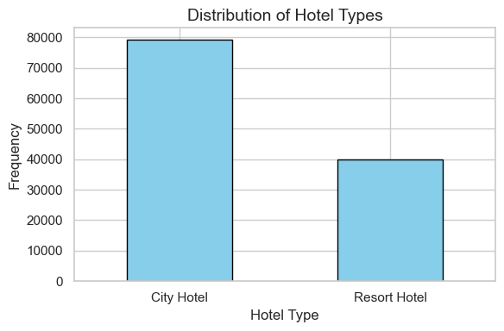
Recap – EDA – Cancellations & Hotel Type

Slide 5
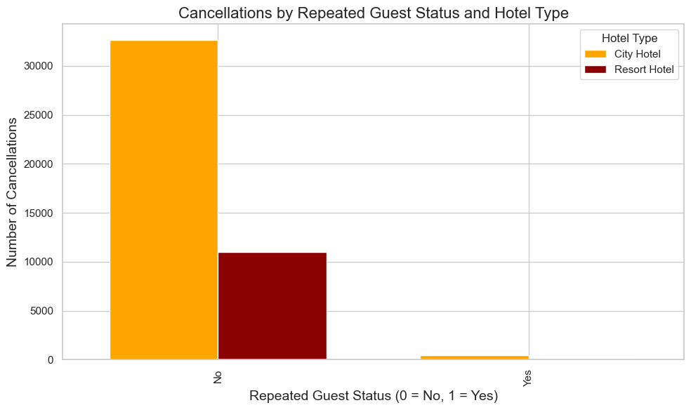
Recap – EDA – Cancellations by …

Slide 6
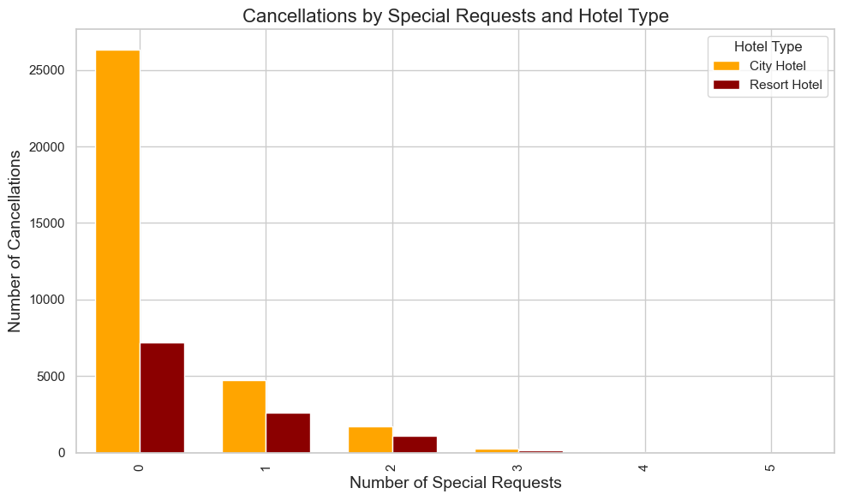
Recap – EDA – Cancellations by …

Slide 7
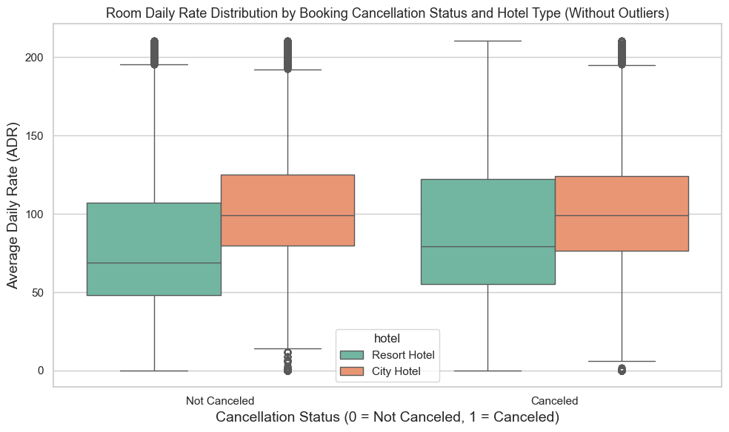
Recap – EDA – Cancellations by …

Slide 8
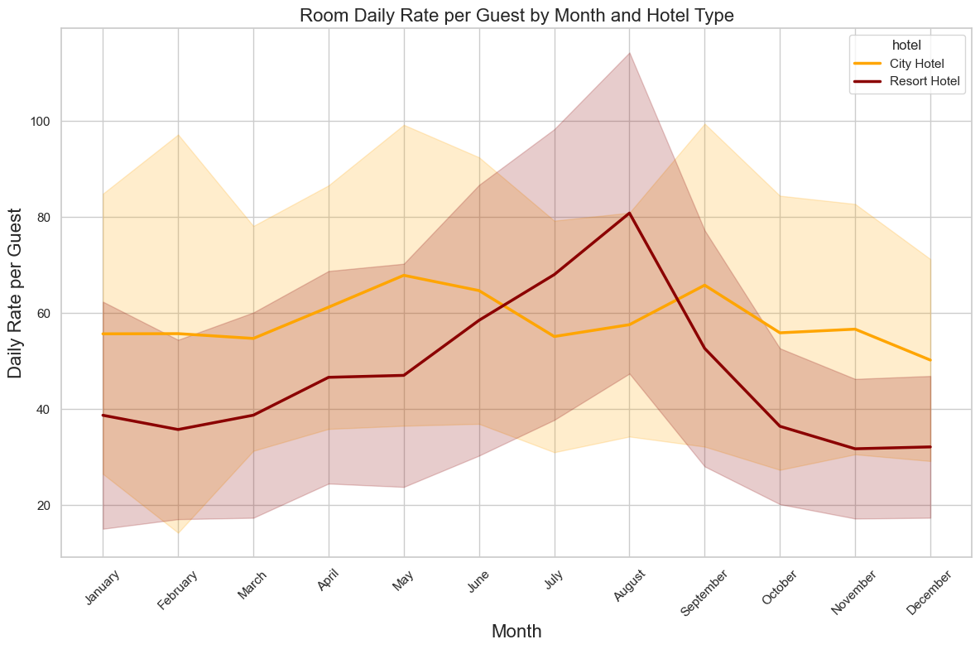
Recap – EDA – Descriptives

Slide 9
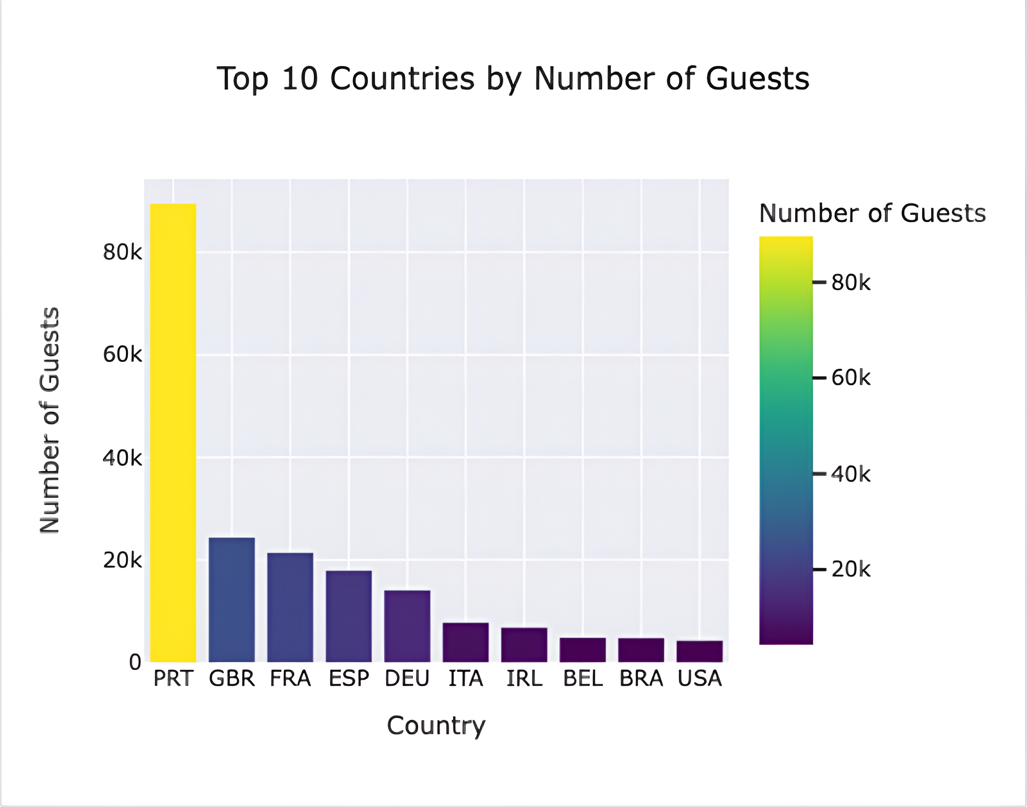
Recap – EDA – Descriptives

Slide 10
Recap – Preprocessing
Splitting strategy: data split into 60% training, validation (20%) and test (20%); random state set to ensure reproducibility
Preprocessors:
Categorical features: missing values in 'country’ (41%) imputed with 'Unknown' using SimpleImputer; one-hot encoding applied to categorical features
Ordinal feature (“arrival_date_month”): standardized using OrdinalEncoder
Numerical features: standardized using StandardScaler to ensure features are on the same scale
Features & data points: original training set shape – (71523, 29) – 10 categorical 19 numerical; preprocessed training set shape – (71523, 231)
Missing values
Country: 41%, imputed & one-hot encoded
Children: 0.3%, number of children, dropped (only 4 rows)
Company: 94.3%, ID of booking company, dropped this column because no need for ID
Agent: 13.7%, ID of travel agency, dropped this column because no need for ID

Slide 11
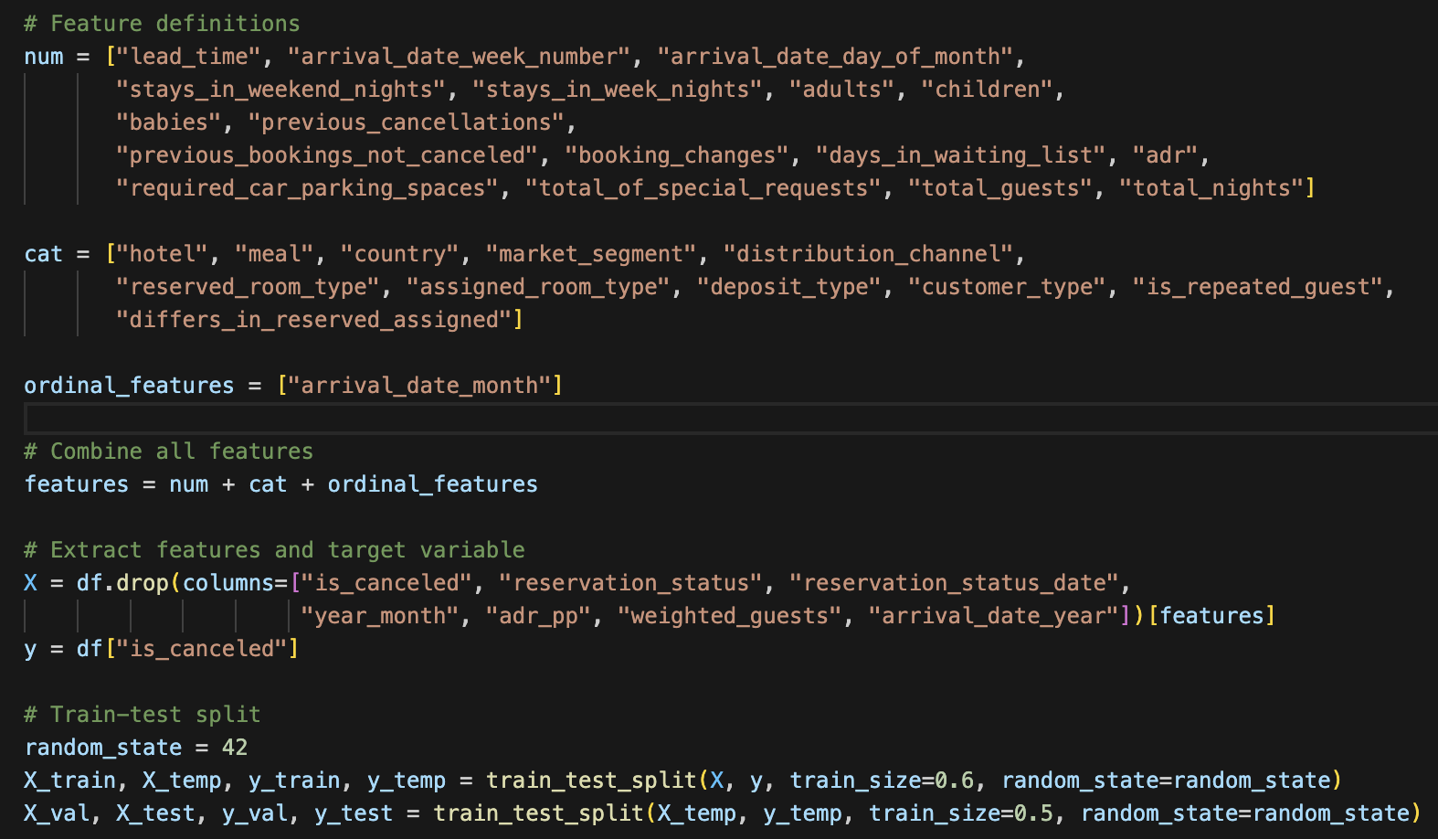
Recap – Preprocessing

Slide 12
Cross Validations – Splitting & CV Pipeline
Splitting strategy: data split into 60% training, validation (20%) and test (20%); random state set to ensure reproducibility
ML Algorithms:

Slide 13
Cross Validations – Logistic Regression
Parameters Tuned:
# Parameters to tune and values
print("Tuned Parameters and Values:")
lr_param_grid = {
"penalty": ["l1", "l2"], # Type of regularization: L1 or L2
"C": [0.1, 1, 10], # Regularization strength
"solver": ["liblinear"], # Use liblinear solver for faster convergence
}
print(lr_param_grid)

Slide 14
Cross Validations – KNeighborsClassifier
Parameters Tuned:
# Parameters to tune and values
print("Tuned Parameters and Values:")
knn_param_grid = {
"n_neighbors": [3, 5, 10], # Number of neighbors to use
"weights": ["uniform", "distance"], # Uniform or distance-based weighting
"metric": ["minkowski"] # Distance metric (default: Minkowski)
}
print(knn_param_grid)

Slide 15
Cross Validations – RandomForestClassifier
Parameters Tuned:
# Parameters to tune and values
print("Tuned Parameters and Values:")
rf_param_grid = {
"n_estimators": [50, 100, 200], # Number of trees in the forest
"max_depth": [5, 10, None], # Maximum depth of the tree
"min_samples_split": [2, 5, 10], # Minimum samples required to split a node
"min_samples_leaf": [1, 2, 4] # Minimum samples required at each leaf node
}
print(rf_param_grid)

Slide 16
Cross Validations – XGBoost
Parameters Tuned:
# Parameters to tune
print("Tuned Parameters and Values:")
xgb_param_grid = {
"learning_rate": [0.01, 0.1, 0.2], # Controls the step size for updating weights
"n_estimators": [100, 200, 500], # Number of boosting rounds
"max_depth": [3, 5, 7], # Maximum depth of a tree
"subsample": [0.8, 1.0], # Fraction of samples used for training each tree
"colsample_bytree": [0.8, 1.0], # Fraction of features used for training each tree
"eval_metric": ["logloss"], # Metric to evaluate during training
"objective": ["binary:logistic"] # Objective function for binary classification
}
print(xgb_param_grid)

Slide 17
Cross Validations – Table Summary of MLs
See Table 1 in Report – then the previous 4-5 slides can be deleted

Slide 18
Results – The Best Model
XGBoost – the best!
A Table Showing Models’ Scores
The plotly plot – see codes…
Baseline accuracy = 0.6293 - calculated as # Calculate baseline accuracy
baseline_accuracy = y.value_counts(normalize=True).max()
print(f"Baseline Accuracy: {baseline_accuracy:.4f}")
1. RF: Test Accuracy Test Precision Test Recall Test F1
mean 0.917948 0.937043 0.834800 0.882952
std 0.001026
2. KN: Test Accuracy Test Precision Test Recall Test F1
mean 0.894166 0.902288 0.801335 0.848802
std 0.001678 0.002533 0.006678 0.003056
3. Log:
Test Accuracy Test Precision Test Recall Test F1
mean 0.826786 0.823993 0.677565 0.743602
std 0.001808 0.003608 0.008495 0.004211 & 4. XGBoost: Test Accuracy Test Precision Test Recall Test F1 mean 0.952728 0.974254 0.896187 0.933583 std 0.001455 0.001804 0.004914 0.002231

Slide 19
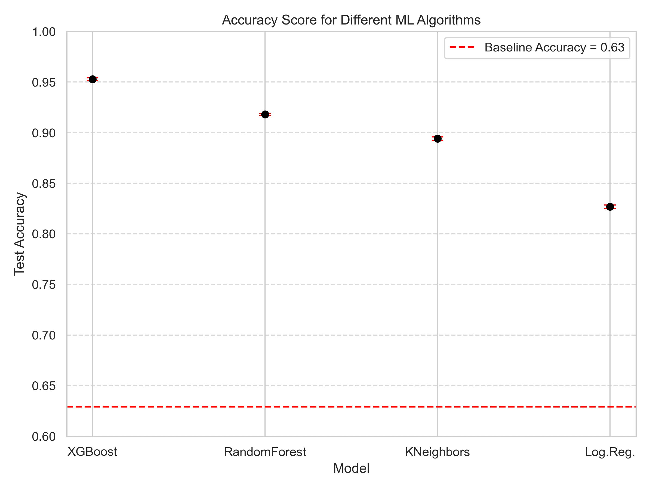
Results – Test Scores
A Figure:

Slide 20
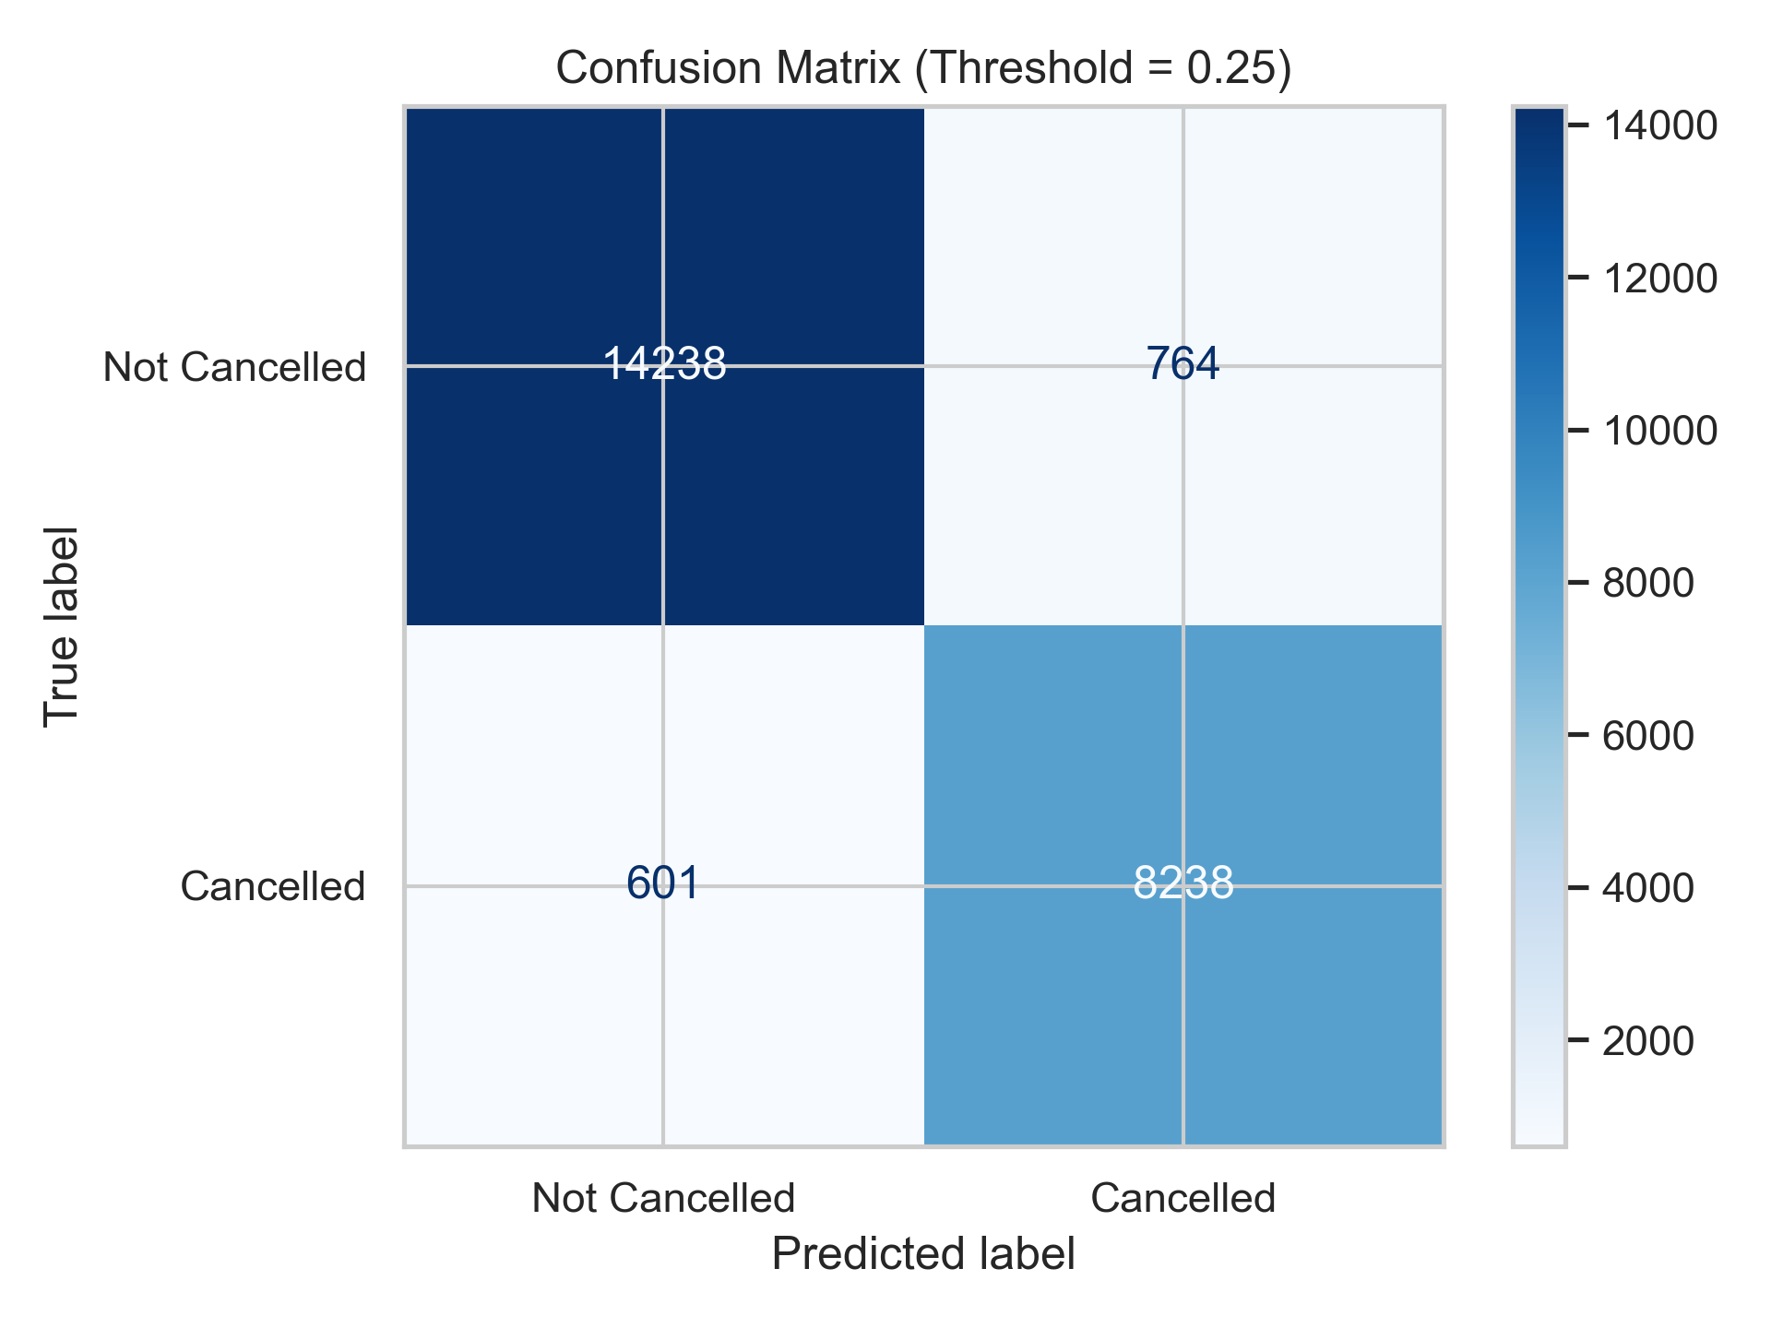
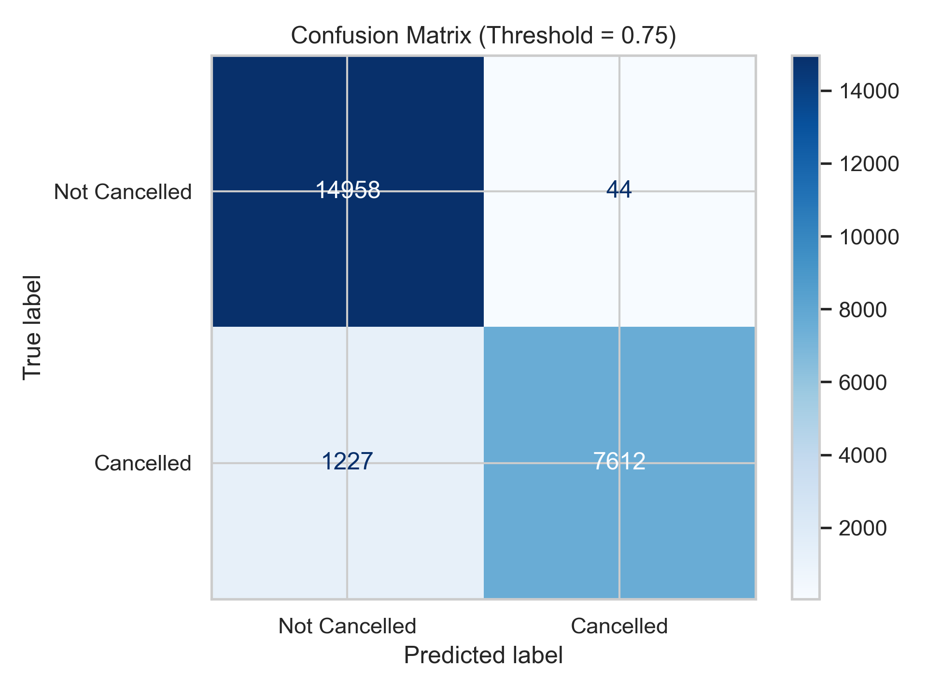

Results – Confusion Matrix
3 Graphs on the best model: XGBoost (25%, 50%, 75%)

Slide 21
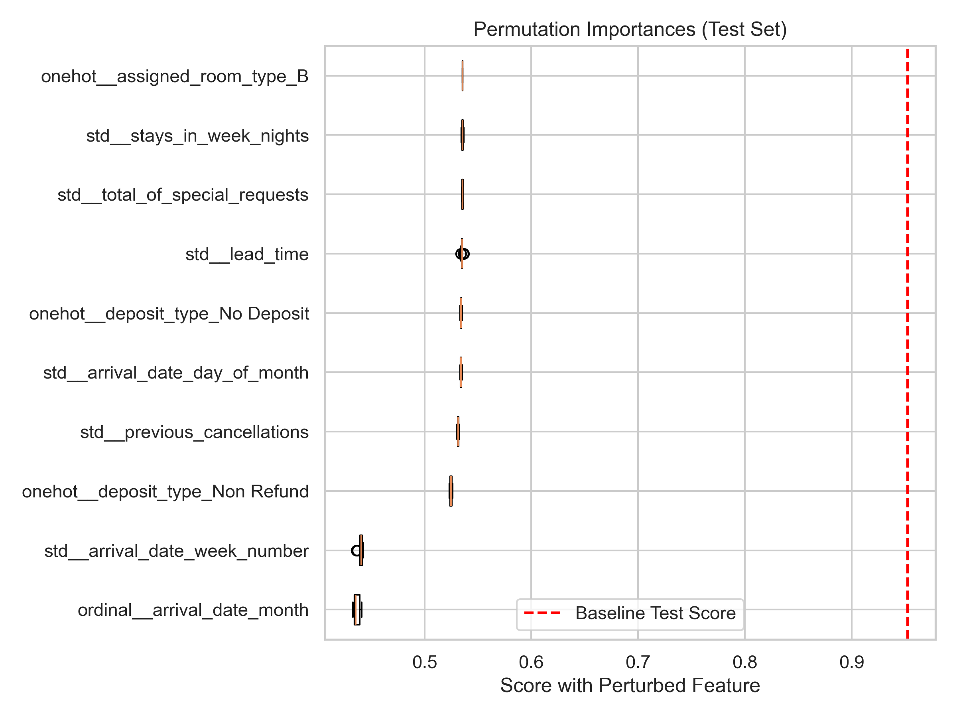
Results – Global Feature Importances
Permutation
Weight, Gain, ….

Slide 22
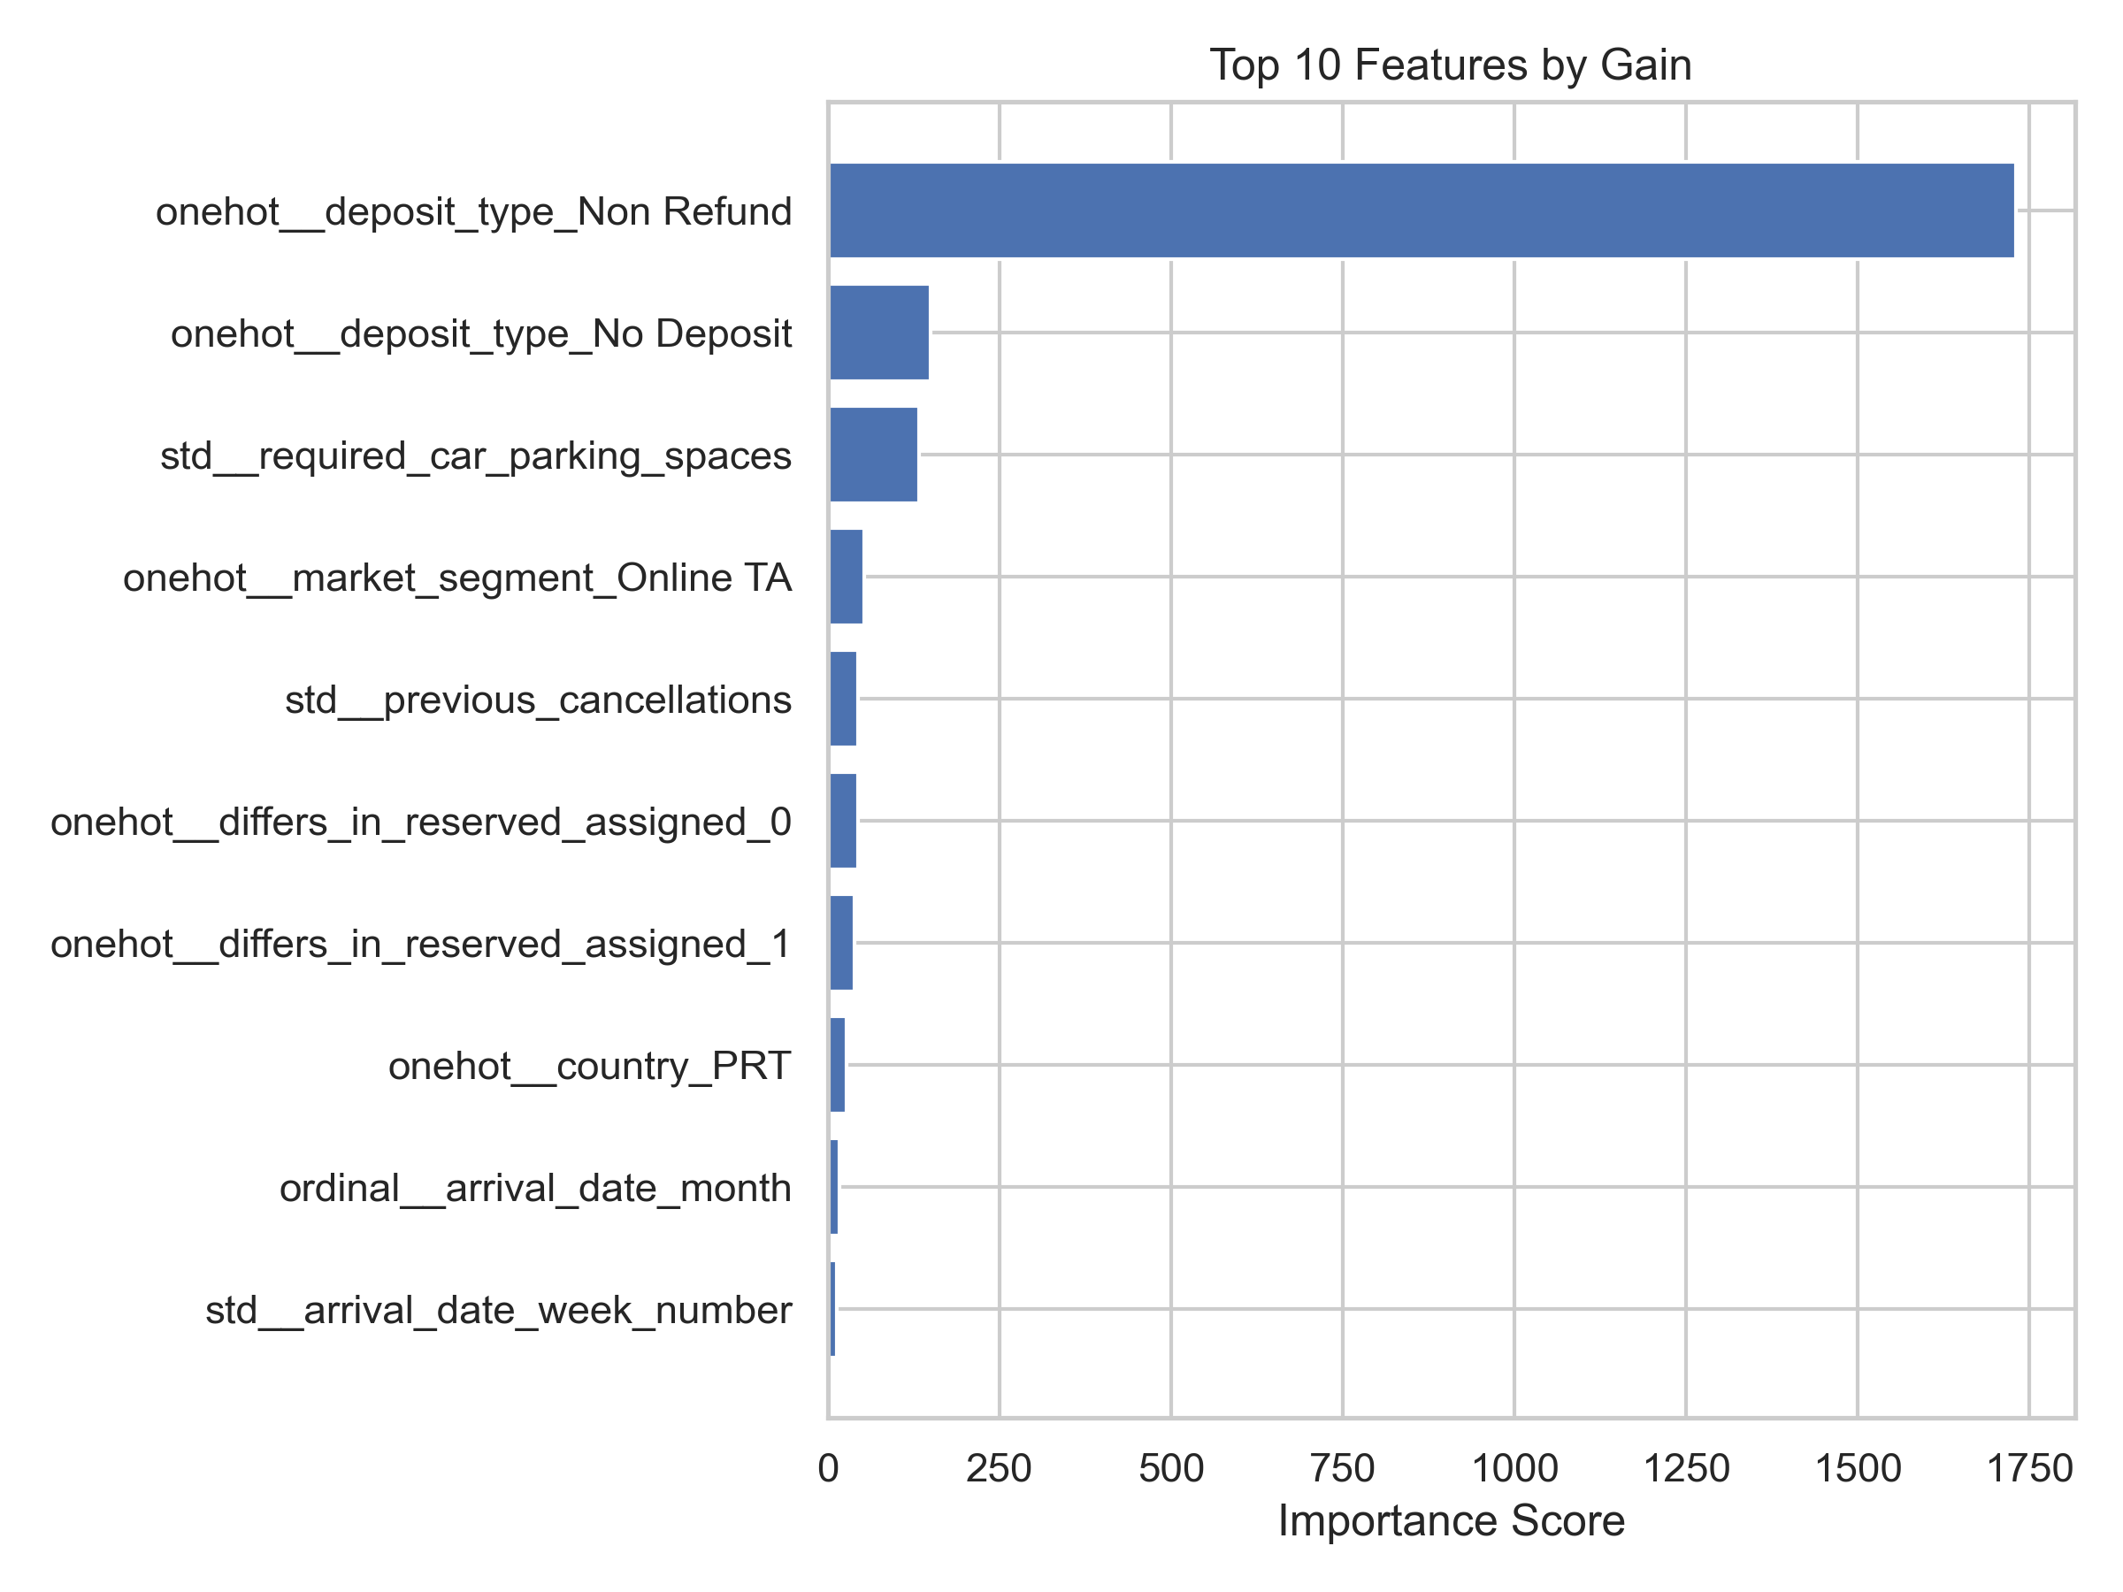
Results – Global Feature Importances
Permutation
Weight, Gain, ….

Slide 23
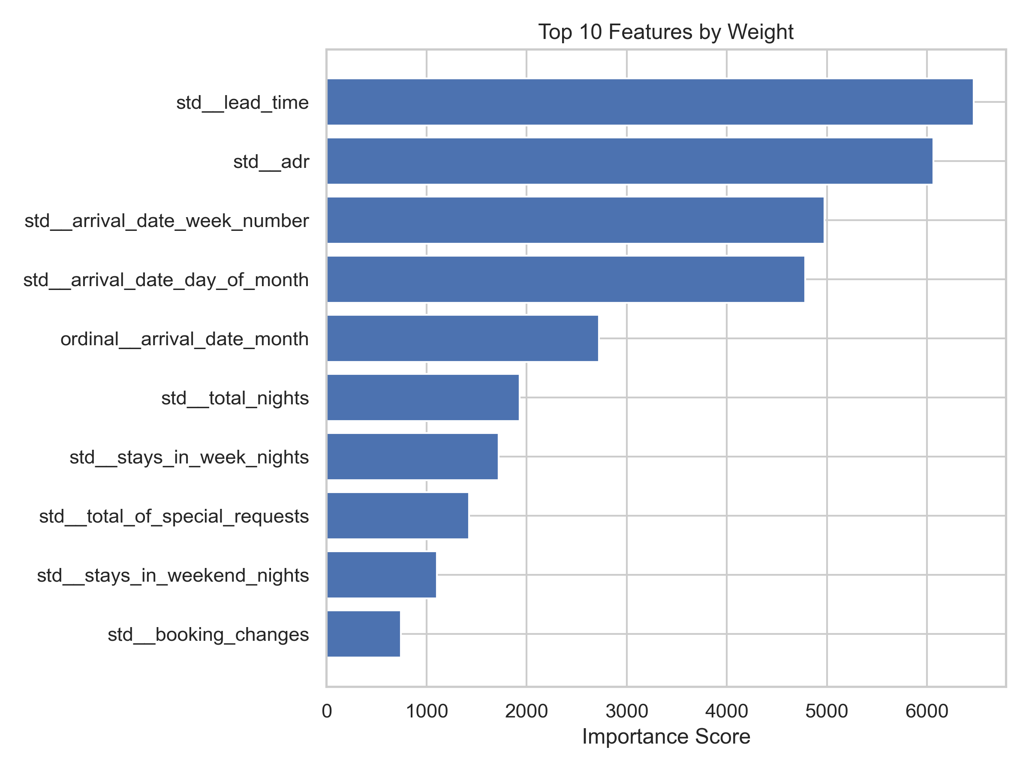
Results – Global Feature Importances
Permutation
Weight, Gain, ….

Slide 24
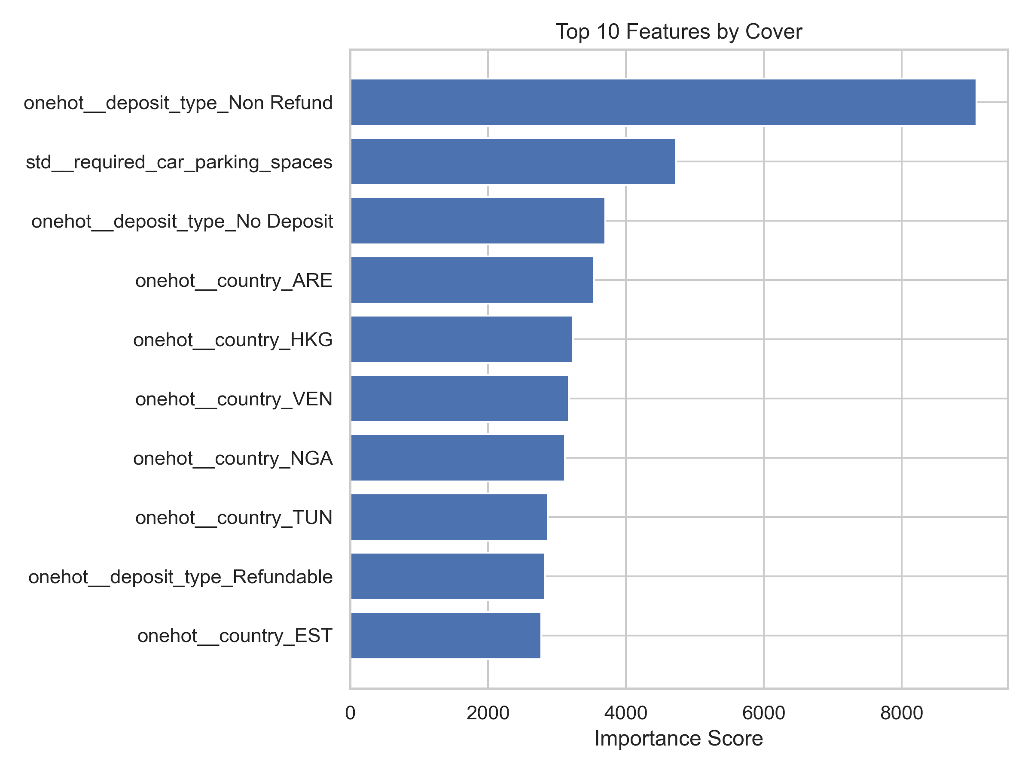
Results – Global Feature Importances
Permutation
Weight, Gain, ….

Slide 25
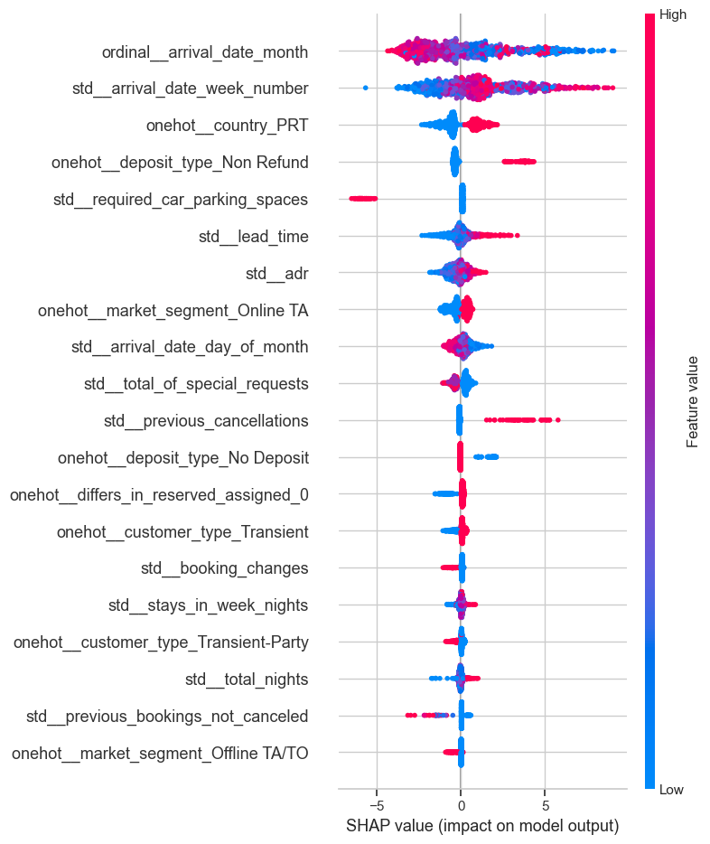
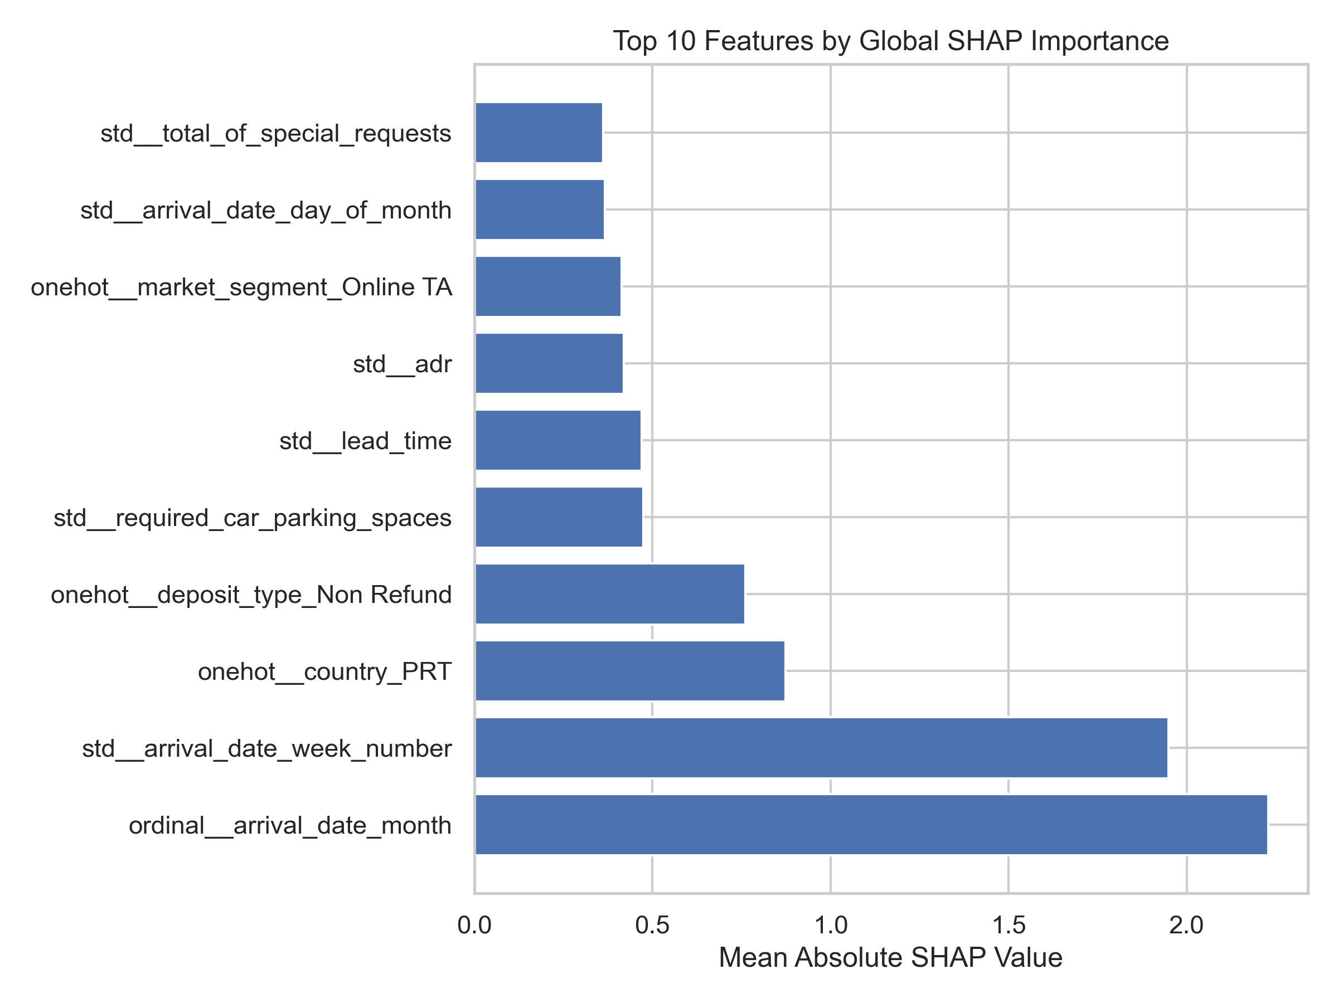
Results – Local Feature Importances (SHAP)
Global SHAP Importance

Slide 26
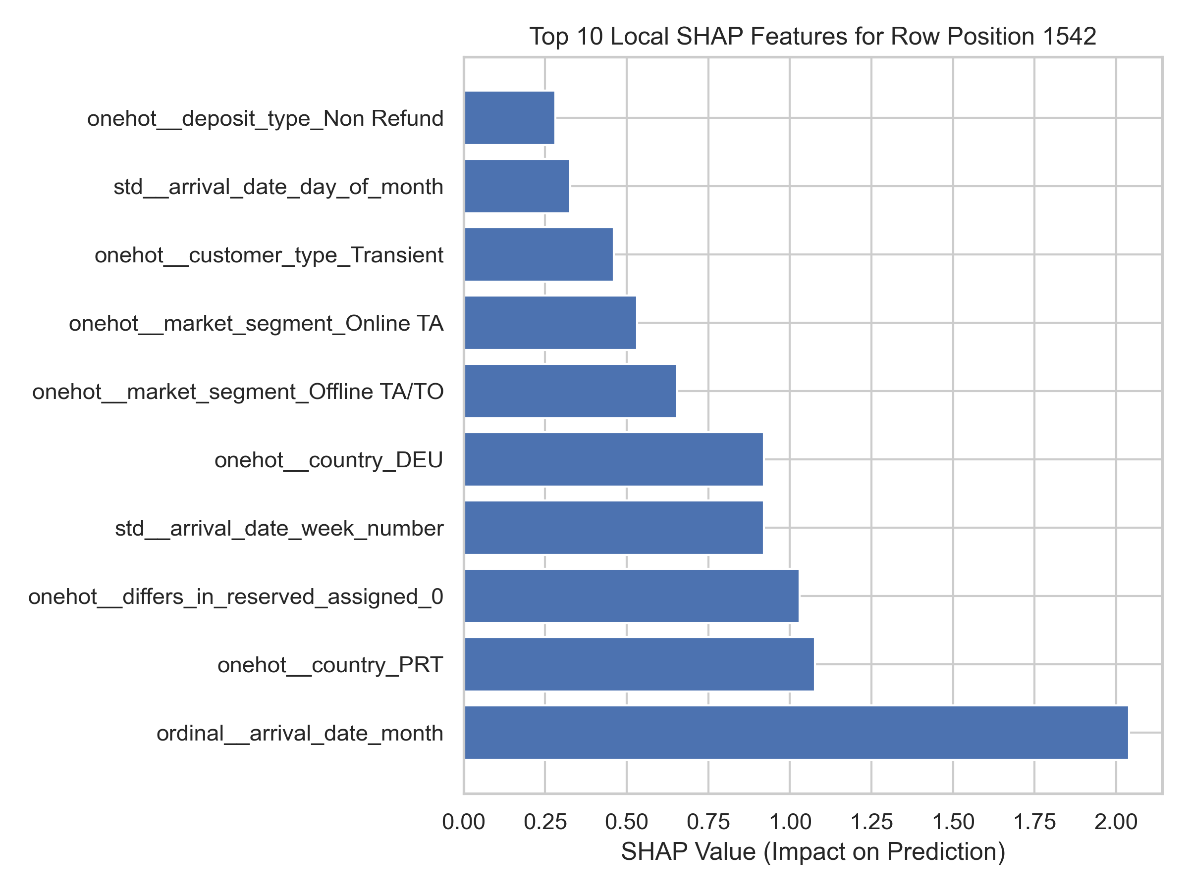
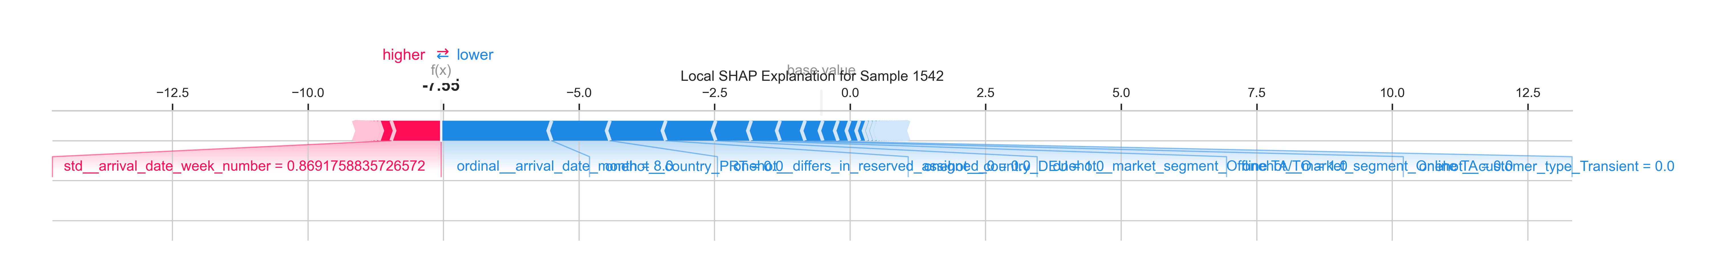
Results – Local Feature Importances (SHAP)
SHAP Index at 1542

Slide 27
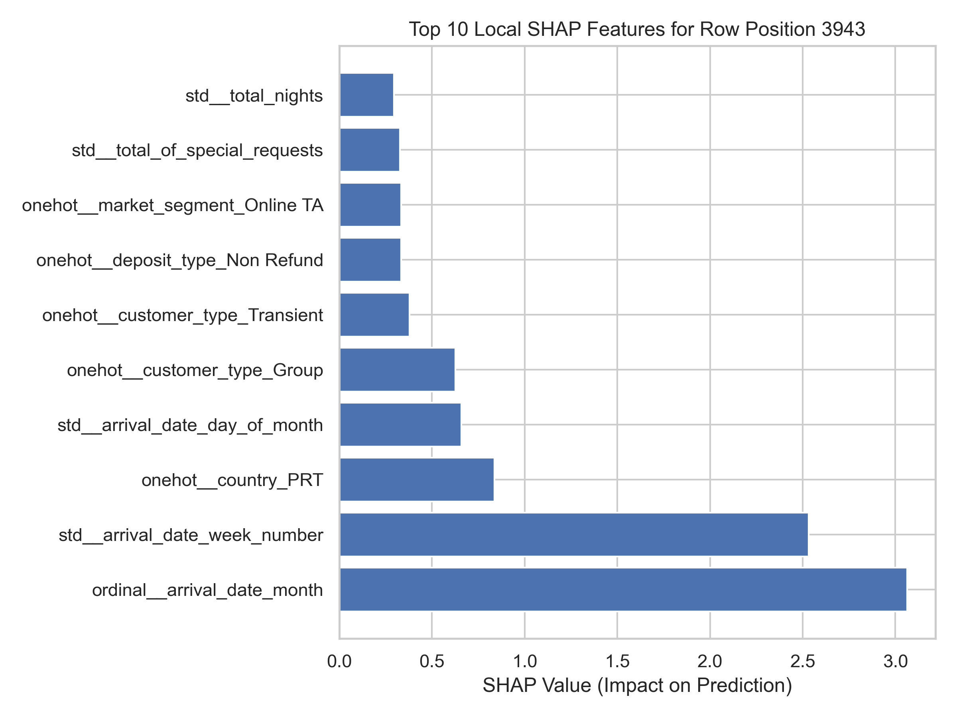
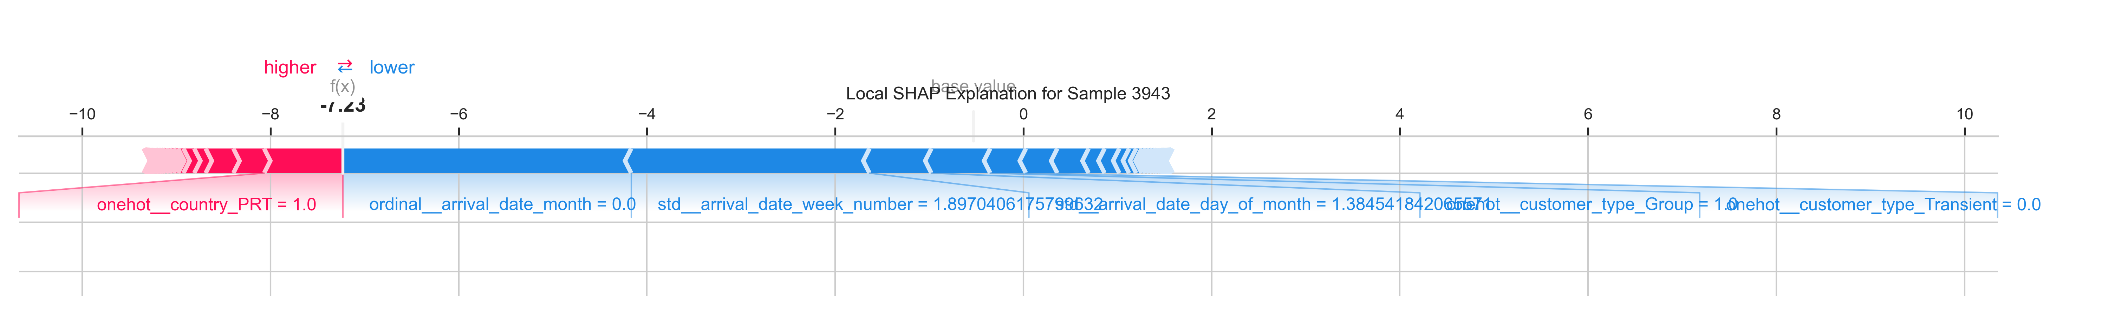
Results – Local Feature Importances (SHAP)
SHAP Index at 3943

Slide 28
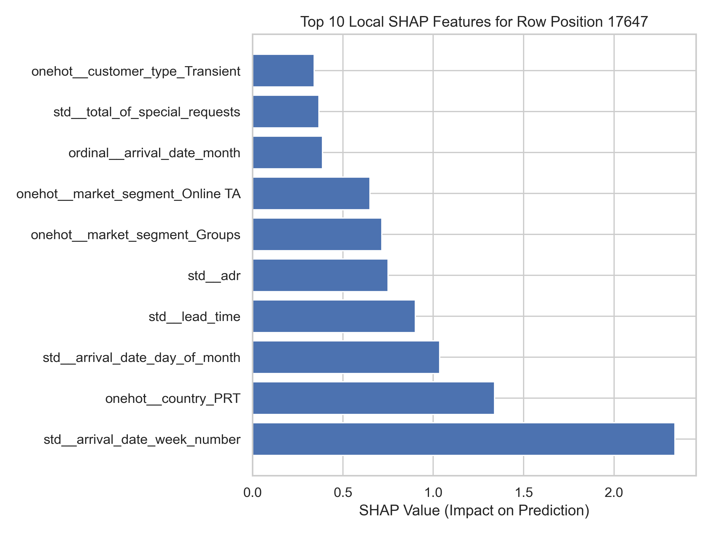
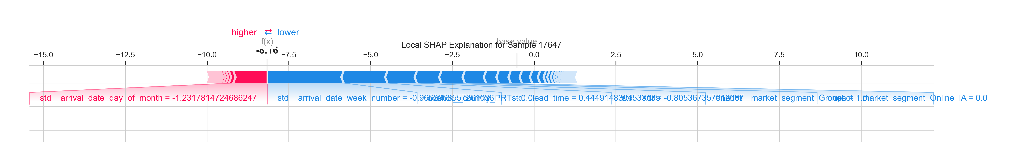
Results – Local Feature Importances (SHAP)
SHAP Index at 17647

Slide 29
Outlooks – Next Steps to Improve
… I will write later

